Slide 1
2021 UGVR
Final Presentation
UGVR Final Presentation 2021/08/31

Slide 2
Seizure Detection in EEG by LSTM Model
Fan Zhang
Dept. of Electronic Engineering, Tsinghua University
Advisor: Yanjun Han, Pulkit Tandon, and Prof. Tsachy Weissman

Slide 3
Background
70 million people in the world have epilepsy.
Seizure detection could promote therapies for epilepsy.

Slide 4
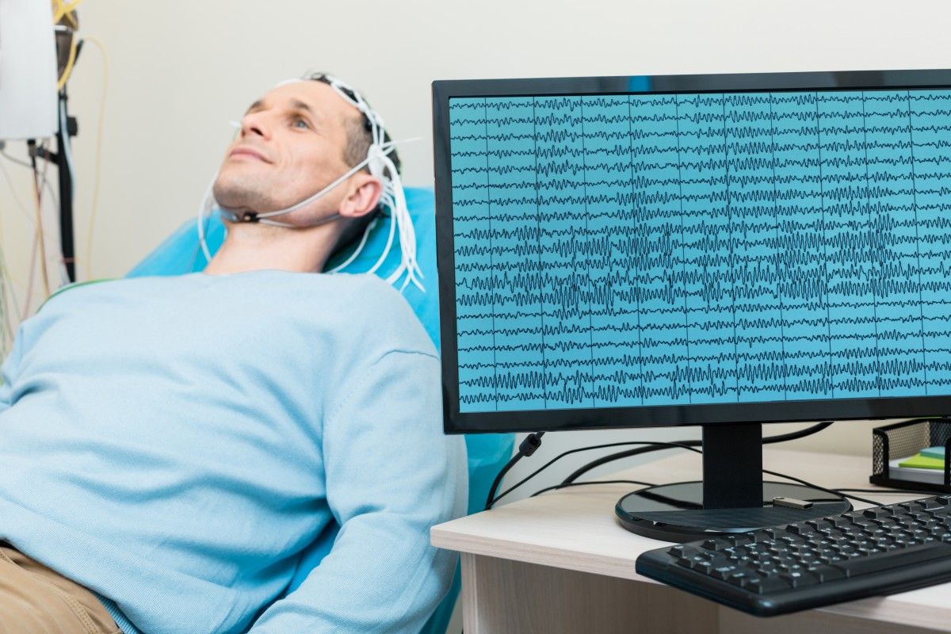
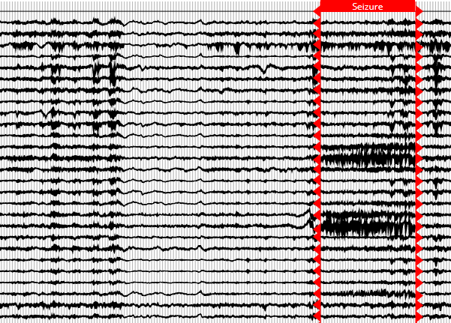
Background
Electroencephalography (EEG)
Seizure Detection in EEG

Slide 5
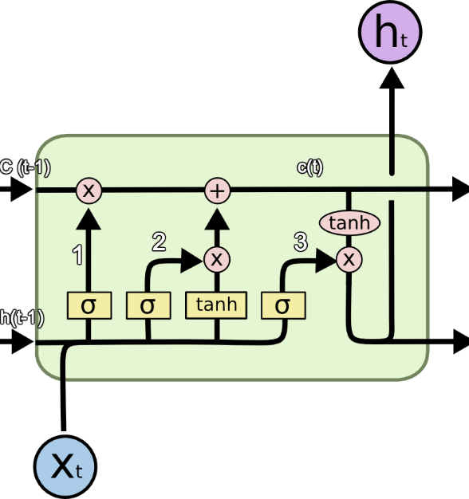
Motivation
Change-point detection
Prediction model
The prediction error would be large during the change points.

Slide 6
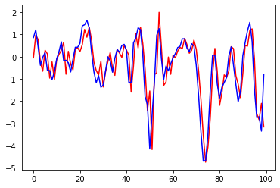
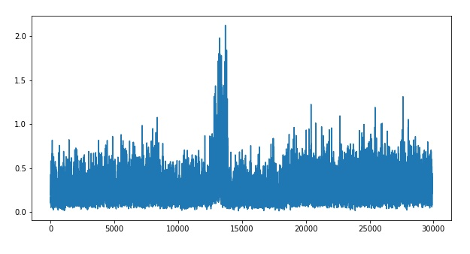
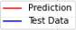
Using LSTM model in seizure detection
Train the model
Predict the future
Calculate the difference

Slide 7
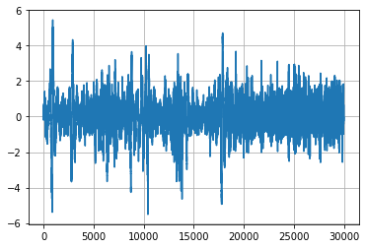
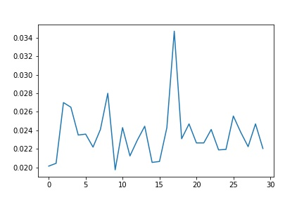
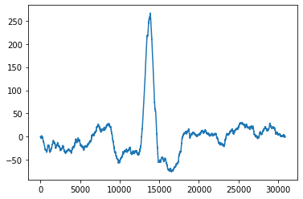

Results
Difference
Original data
Seizure
Sum of moving window
ICR

Slide 8
Thank You for Listening! Welcome to Breakout Room 1

Slide 9
3D Face Reconstruction With Deep Fake Face Texture
Haodi He
School of the gifted young, USTC
Advisor: Prof. Ron Fedkiw, Yilin Zhu
Co-Author: Justin Shao

Slide 10
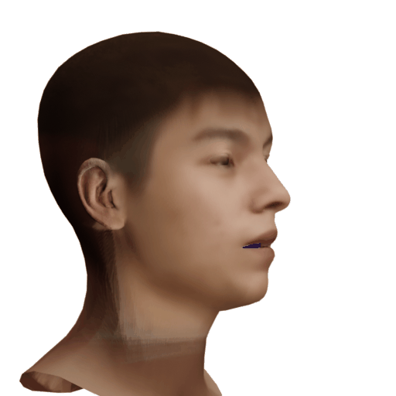

One-minute-long video
Notes:
That’s all of my introduction.
I am Zhuoer Feng from Tsinghua University.
If you want to further discuss with me, welcome to join breakout room 3.

Slide 11


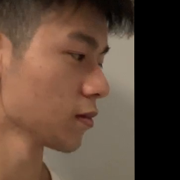

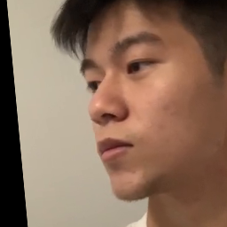

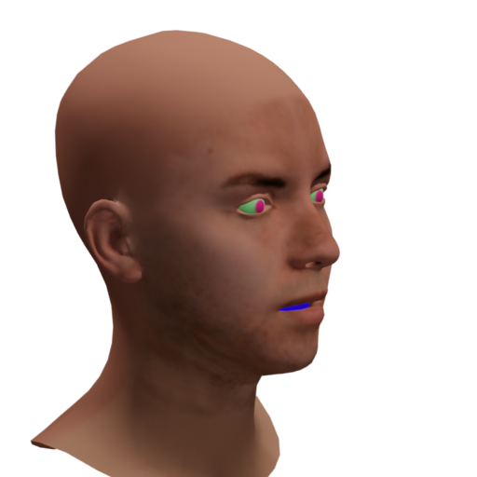
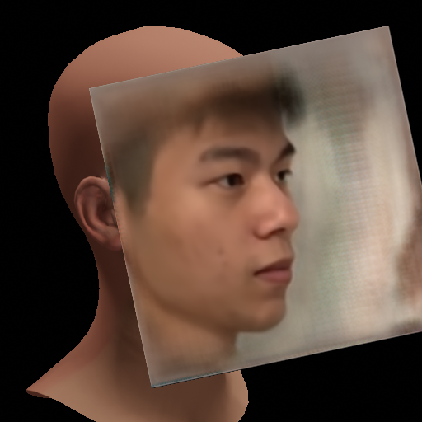
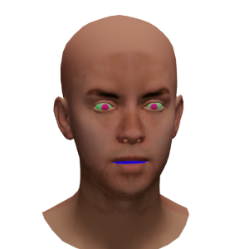
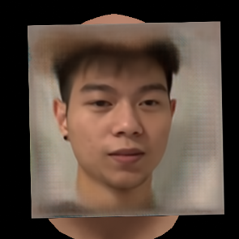
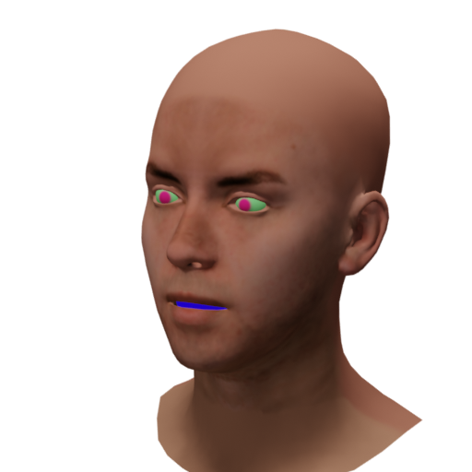
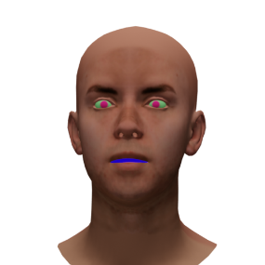
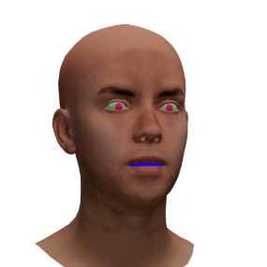
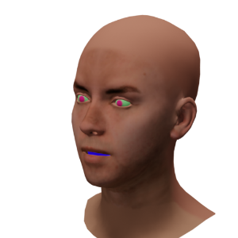
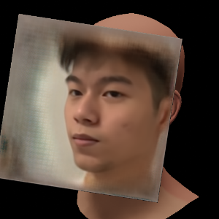
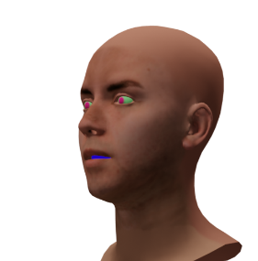
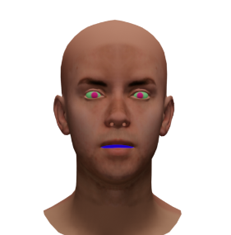
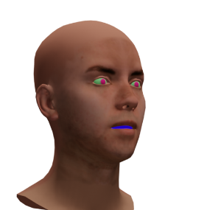

Problem: Misaligned to the 3D Geometry
Generate texture
Inference
Train
Deep Fake
Fake but Aligned to the 3D Geometry
Rendered Faces
Notes:
That’s all of my introduction.
I am Zhuoer Feng from Tsinghua University.
If you want to further discuss with me, welcome to join breakout room 3.

Slide 12
Thank You for Listening! Welcome to Breakout Room 1
Notes:
That’s all of my introduction.
I am Zhuoer Feng from Tsinghua University.
If you want to further discuss with me, welcome to join breakout room 3.

Slide 13
Efficient Neural Inductive Logic Programming
Guangxuan Xiao
Dept. of Computer Science, Tsinghua University
Supervisors: Prof. Jiajun Wu, Jiayuan Mao
Notes:
Hello everyone, I am Guangxuan Xiao from the Department of CS at Tsinghua. I am very fortunate to be advised by Jiajun Wu and be mentored by Jiayuan Mao from MIT.
Our project is about efficient neural inductive logic programming.

Slide 14

Inductive Logic Programming (ILP)
With known facts, ILP systems derive general definitions of targets.
v
father
mother
A mother is a female parent.
a: male
d: female
ILP System
parent
parent
parent
Train
A father is a male parent.
b
c: female
Training Example: A family of four.
Notes:
So what is Inductive logic programming?
An ILP system can derive definitions of predicates generalized to background facts.
For instance, we know the facts of a family of 4 shown as follows.
An ILP system can to learn expressions of father and mother from this family so that we can identify fathers and mothers in any other family.

Slide 15
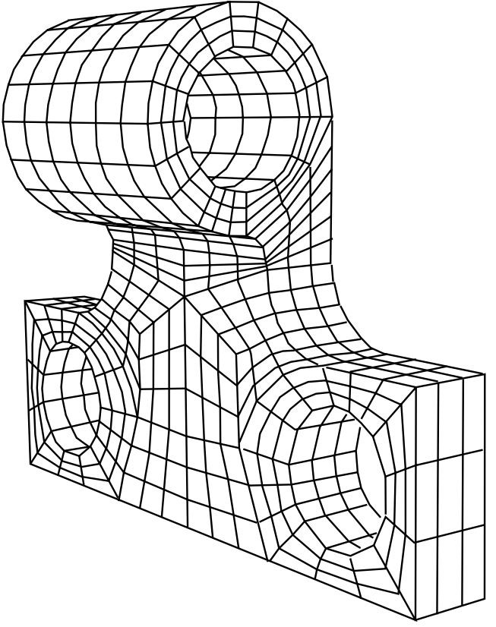
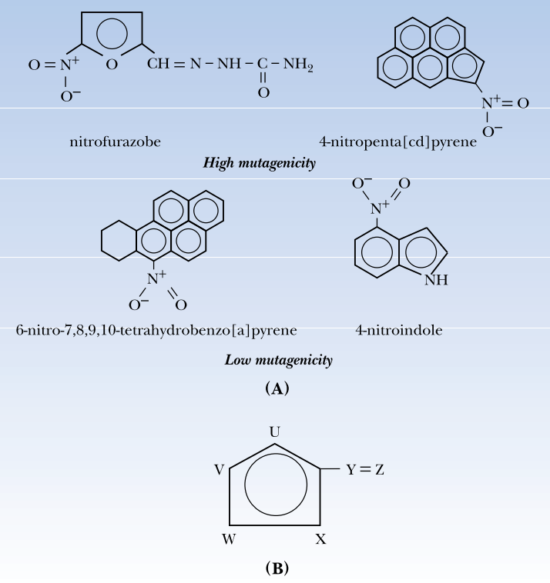
Inductive Logic Programming (ILP)
Strength: Learn general rules from a few small worlds.
Finite Element Mesh Design
Mutagenicity Prediction
Notes:
As we can see, ILP systems can learn general rules from a few small worlds.
They can apply to more critical problems such as finite element mesh design and Mutagenicity prediction of Chemical Compounds.

Slide 16
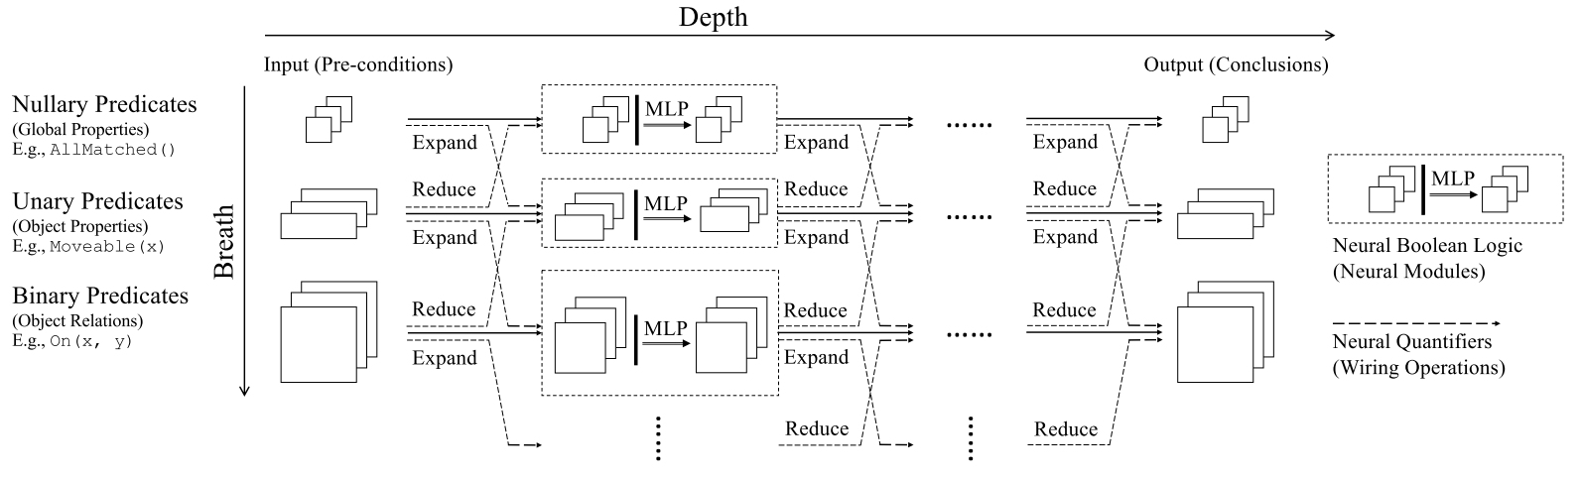
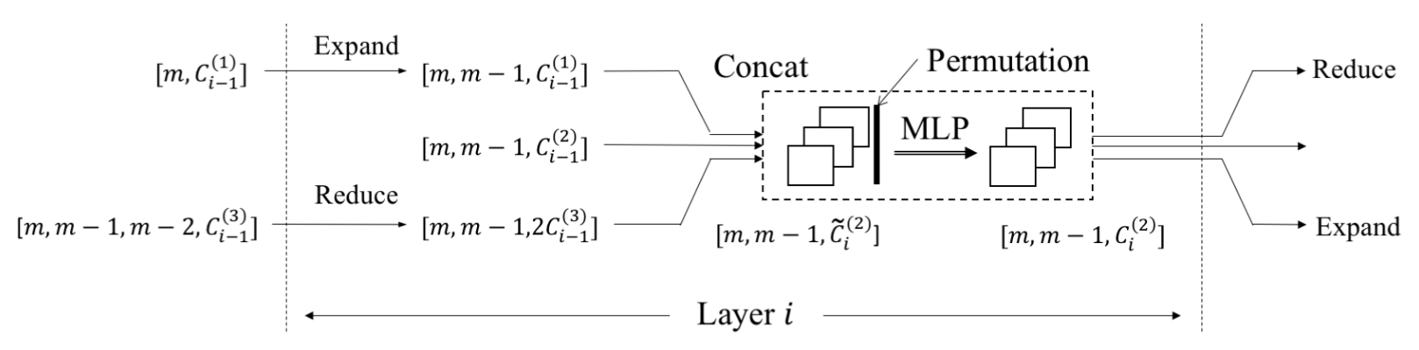
Neural Inductive Logic Programming
- Advantage: More robust by using fuzzy (probability) logic to handle noisy data.
- Disadvantage: Computational complexity is too high ($O\left({r!n}^{r}\right)$).
Neural Logic Machine (NLM)
Notes:
Recent researchers have developed ILP systems with neural networks, whose main advantage is handling noisy inputs.
However, the training and inference complexities of previous methods are too high for real-world data.

Slide 17
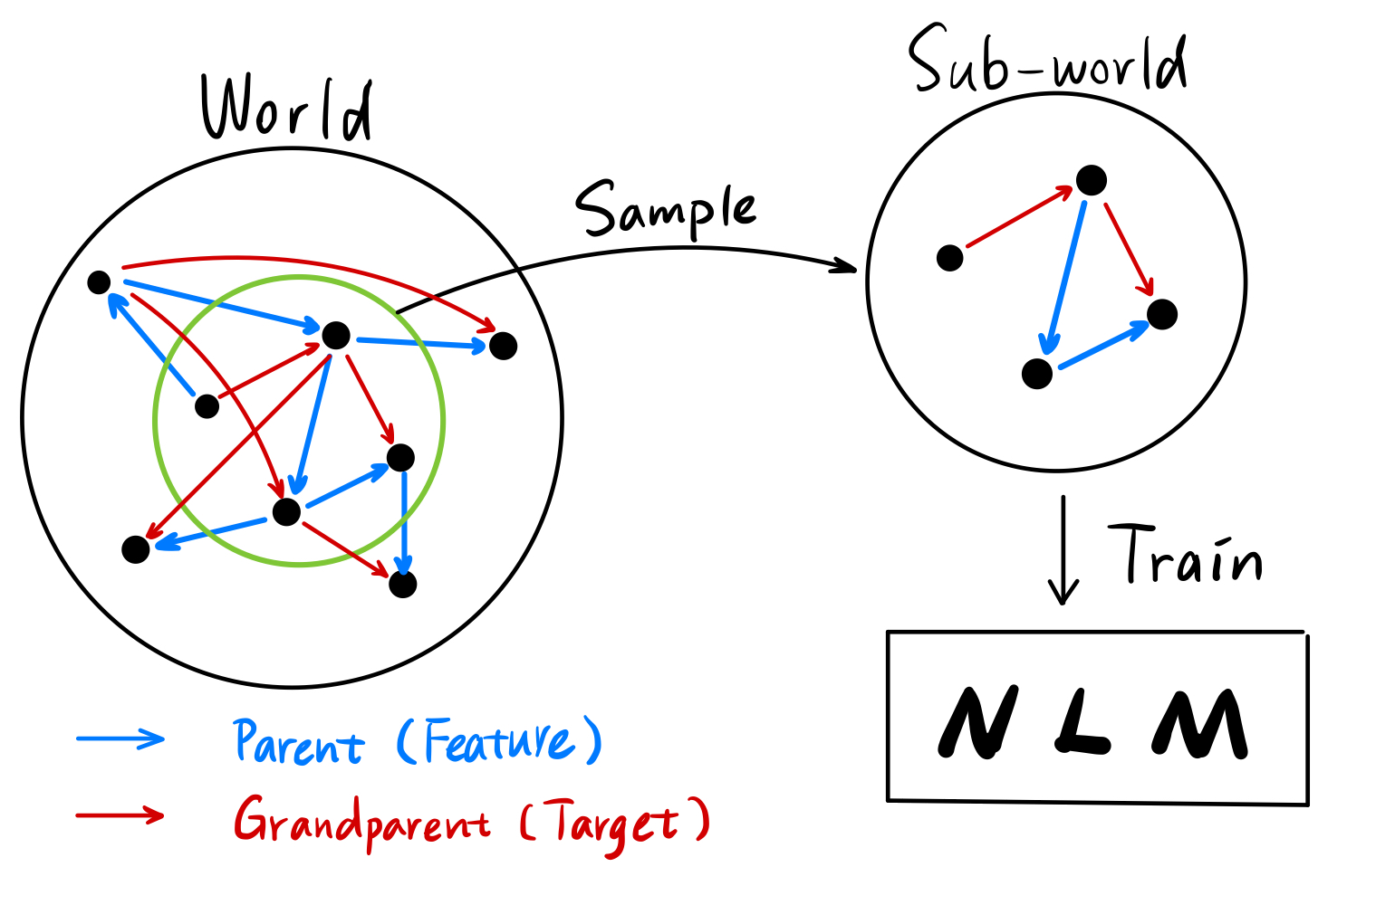
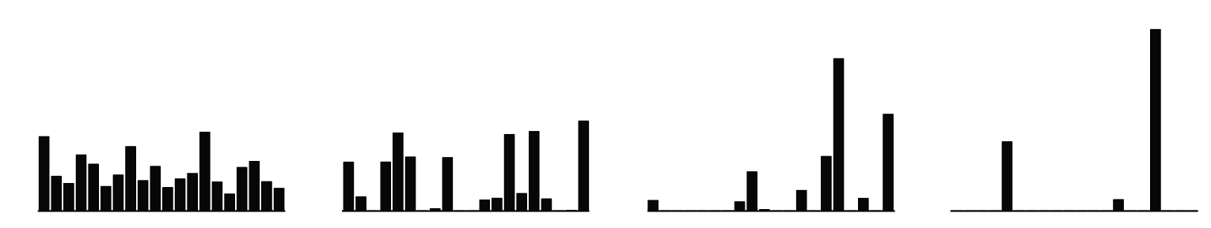
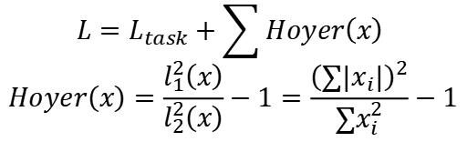
Sparse NLM (SNLM): Efficient Neural ILP
Regularization Loss
to Encourage Sparsity
Sample Sub-worlds to
Train and Infer on Real-world Data
$$L=L_{task}+\sum{Hoyer\left(x\right) }$$
$$Hoyer\left(x\right)=\frac{l_{1}^{2}\left(x\right)}{l_{2}^{2}\left(x\right)}−1=\frac{{\left(∑\left|x_{i}\right|\right)}^{2}}{∑x_{i}^{2}}−1$$
Hoyer: 0.9 0.6 0.3 0.1
Dense
Sparse
Notes:
Here we propose a neural-symbolic framework for efficient ILP.
Our framework consists of two major components.
First, we add regularization loss at predicates to encourage the sparsity of models.
Second, we design sampling algorithms to train and infer on real-world big data.

Slide 18
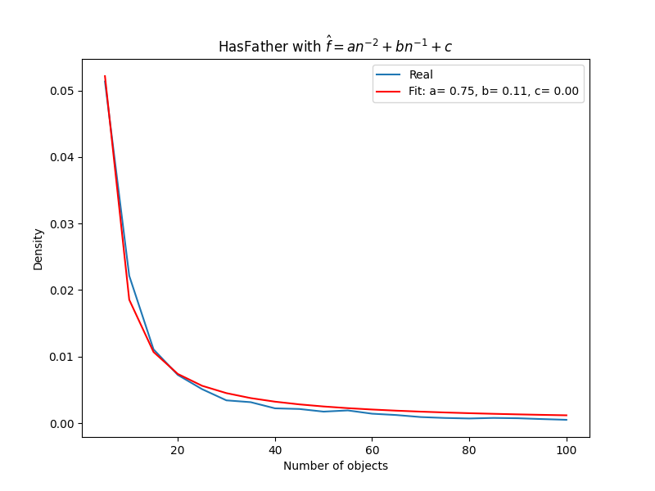
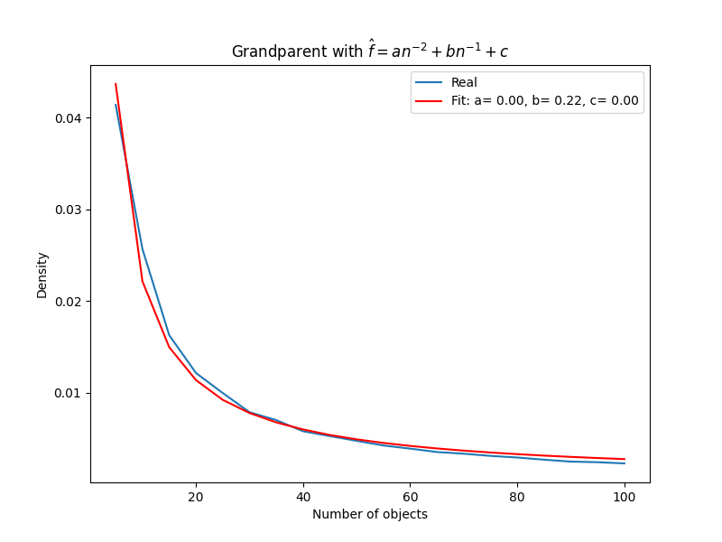
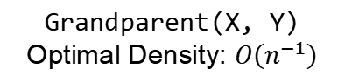
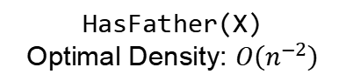
Result: Reaching Optimal Density
HasFather(X)
Optimal Density: $O\left(n^{−2}\right)$
Grandparent(X, Y)
Optimal Density: $O\left(n^{−1}\right)$
Notes:
Experiments prove the effectiveness of our approach.
With the regularization loss, our model can converge to the optimal sparsity to solve problems.

Slide 19
Result: Sub-world Training Gets Perfect Accuracy
Model | HasFather | Grandparent | Uncle | MGUncle
NLM | - | - | - | -
SNLM (RW) | 100 | 100 | 100 | 100
SNLM (Neighbor) | 100 | 100 | 100 | 100
Table 1: Performance of models trained on large families with 5000 people.
Our models (SNLMs) achieve perfect accuracies, while baseline models (NLMs) cannot work because of out-of-memory (OOM). Numbers are testing F1 scores showed in percentages.
Notes:
Trained and tested on sampled sub-worlds, our models achieve perfect accuracy, while the baseline cannot train because of out-of-memory.

Slide 20
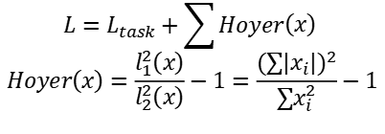
Conclusion
We extend Neural ILP to Real-world Applications.
We hope our Neural-Symbolic model can contribute to General AI.
$$L=L_{task}+\sum{Hoyer\left(x\right) }$$
$$Hoyer\left(x\right)=\frac{l_{1}^{2}\left(x\right)}{l_{2}^{2}\left(x\right)}−1=\frac{{\left(∑\left|x_{i}\right|\right)}^{2}}{∑x_{i}^{2}}−1$$
Hoyer: 0.9 0.6 0.3 0.1
Dense
Sparse
Notes:
In conclusion, our framework extends neural ILP systems to real-world applications.
We expect our model can contribute to the general artificial intelligence.

Slide 21
Thank You for Listening! Welcome to Breakout Room 1
Notes:
Thank you for listening! Welcome to chat with me about the details in breakout room 1.

Slide 22
REAL: Indoor Multi-object Relationships Exploration by Active Learning from Interaction
Qi Li
School of Software, Tsinghua University
Supervisors: Prof. Leonidas Guibas, Prof. Hang Zhao, Kaichun Mo, Yanchao Yang
Notes:
Hi, I’m Qi Li from Tsinghua University, advised by Professor Leonidas Guibas. My research topic this summer is multi-objects Relationship Exploration by active learning from interaction. (click)

Slide 23




Motivation
Multi-objects relationship!
Notes:
Imagine that you step into the hotel room on a hot summer day. The first thing you might want to do is to turn on the air conditioner.
So how should we do this since the air conditioner is hanged /hæŋd/ on the wall? (click)
Well, there might be a remote for you, or a air conditioner switch, or even, you can directly control the air conditioner by your phone. (click)
As we can see, there are rich multi-object relationships in our daily life.
And in this project, we let robots build this kind of relationship automatically by active interaction. (click)

Slide 24
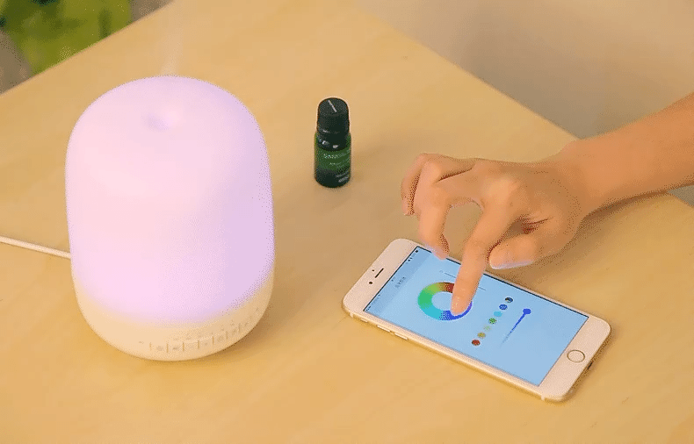

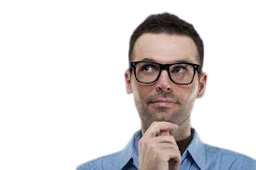
How does human build multi-object relationships?
Prior knowledge
Active exploration
Notes:
Let’s firstly recall how does our human build relationships. (click)
Suppose you see a switch on wall, you may expect this will turn on a light bulb even without toggling it. This comes from your strong prior knowledge. (click)
And even if you are unfamiliar with some novel objects, the solution is simple, you just actively interact it and learn the relationship! (click)

Slide 25
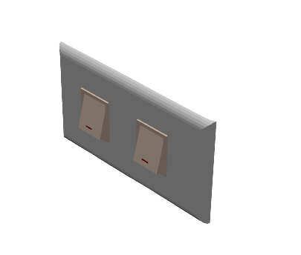
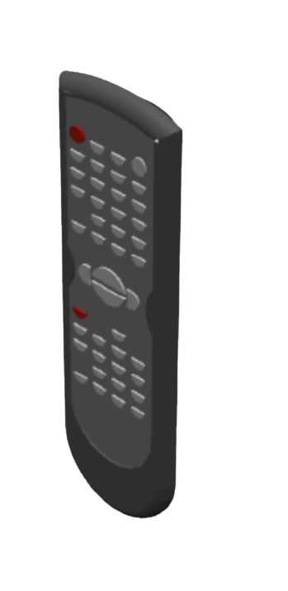
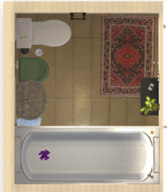
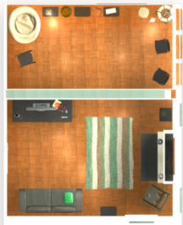
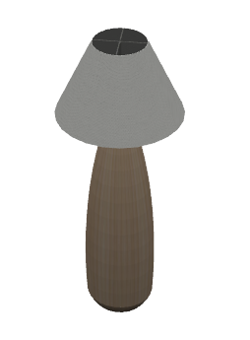
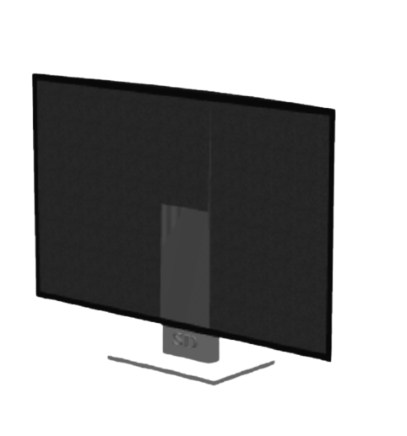
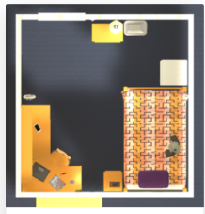


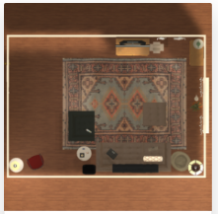
Multi-object Relationships Learning
Interaction
Prior knowledge
New scene
Large-scale scenes
Exploration policy
Notes:
So to mimic the human behaviors, we also let agent learn prior knowledge and the exploration policy by actively interacting with large-scale scenes. And those knowledge can then be used for new scene exploration. (click)

Slide 26

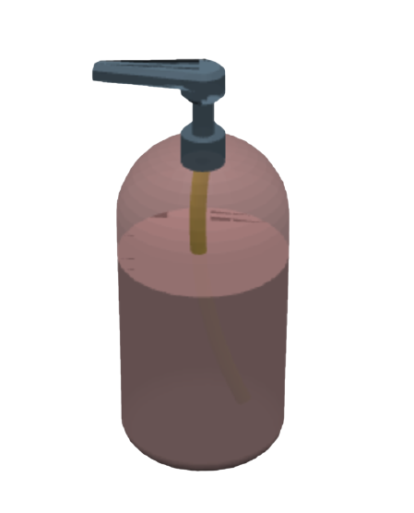
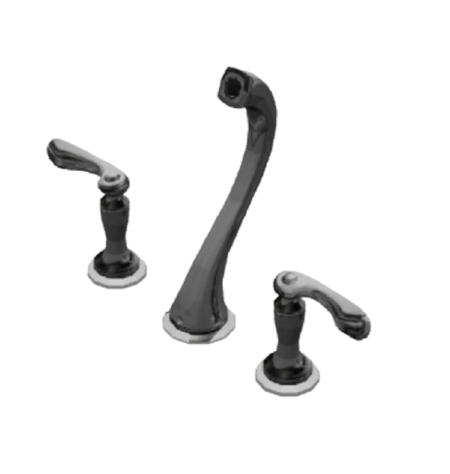
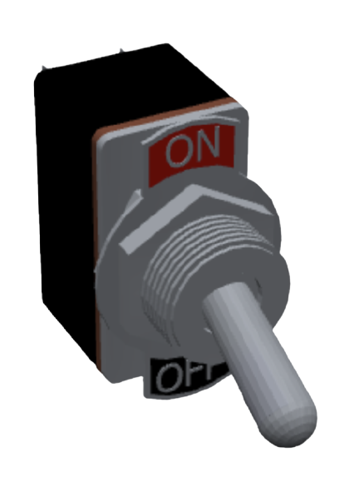
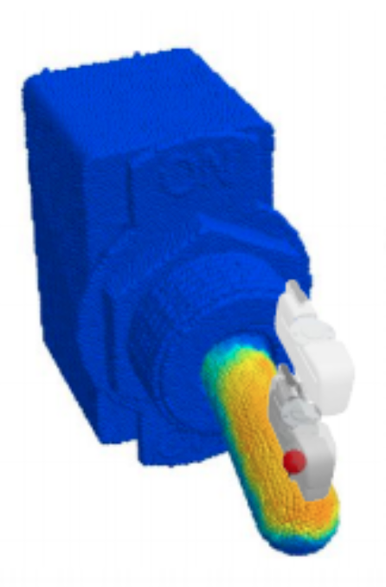



What we do
And now we know
how to open the air conditioner!
Construct multi-object relationships in the room
Mo, Kaichun, et al. "Where2act: From pixels to actions for articulated 3d objects." arXiv preprint arXiv:2101.02692 (2021)
Notes:
Here is what we can do, we construct multi—object relationships in the room, and now we know how to open the air conditioner! (click)

Slide 27


Model Inference
Inference
Notes:
To wisely build objects’ relationship, the robot should be able to make inference based on partial observation.
For example, suppose there are two buttons in the room controlling the two lamps, but we don’t know the exact correspondence. (click)
If now we observe the first button controls the first lamp, then our robot can infer that the second button is most likely used to control the second lamp. (click)

Slide 28
Thank You for Listening! Welcome to Breakout Room 2
Notes:
If you are curious about how we achieve this, plz come to breakout room 2 for details, my name is Qi Li. Thank you, Leo and mentors for kind guidance, Thanks for listening.(click)

Slide 29
Effective Prediction and Imputation of Gene Expression at Nucleotide Resolution
Yangyuan Zhang
Department of Automation, Tsinghua University
Supervisors: Prof. Anshul Kundaje, Jacob Schreiber

Slide 30

Various Forms of Genomic Tracks
Various Forms of Genomic Tracks
ENCODE Encyclopedia:
https://www.encodeproject.org/data/annotations/v3/

Slide 31


Imputation Model for Genomic Data
Extra information?
Celltypes
Specific Assays
…….
DNA Sequences
Prediction
Module
Genomic Profiles

Slide 32

Model Architecture
One-hot Sequence
Conv1d
Assay Embedding
BPNet-like Architecture
Profiles
Conv1d
Cell-type Embedding

Slide 33
Model Architecture
Conv＆Softmax
(1, 1000)
Concatenate (Mix Channels)
(2*n_filters, 1000)
Conv1d
Conv1d
(n_filters, 1000)
(n_filters, 1000)
Cell-type-specific Layer
Assay-specific Layer

Slide 34


Imputation Results

Slide 35
Thank You for Listening Welcome to Chat with Me
Breakout Room 2
Computer Science
Yangyuan Zhang
Department of Automation, Tsinghua University
Supervisors: Prof. Priyanka Raina, Haitong Li
Notes:
Thanks for your listening! Welcome to discuss with me at breakout room 3!

Slide 36
Bayesian Active Learning For Tool Manipulation
Zhuoer Feng
Department of Computer Science and Technology, Tsinghua University
Supervisors: Prof. Silvio Savarese, Kuan Fang, Fei Xia

Slide 37


Motivation
Roadblocks
Lack of data
High time & calculation cost for one trial
Searching space is large
Notes:
Robotic training is difficult.
Different robot environment usually cannot share the same model.
In simulation and realtime training, one step took over thousands of calculation steps.
And the action of sawyer is continuous in space, which is countless.

Slide 38




Active v.s. Passive Learning
Types of learning
Active
Passive learning
addition
Active
Learn suitableness for current
High digest efficiency
Passive Learning
Learn randamly
Low digest efficiency
multiplication
equation
learn by need
learn randomly
calculus
Notes:
In search for acceleration and lower the cost, we reflect in two ways of learning: active and passive.
Active learning is intuitive: learning from easy to hard, learning what is needed exactly.
Passive learning is trouble some: traversing from all data with imitation.

Slide 39

Active Learning Pipeline
Unseen tasks
Task Agent
Policy Agent
acquire
sample
Task Value Network
Most
Inconfident
Task
Soft Actor Critic Network
Task Parameter
Policy Agent Replay Buffer
state, action
Task Agent Replay Buffer
Sample: Task/Succ
trial
Replay Buffer:
Temporarily places samples
Task Value Network:
Predict a score for each task
Soft Actor Critic Network:
Reinforcement learning framework
Notes:
Here we designed a pipeline for active learning.
An task agent train a value network to score the tasks, so that it can actively select the task.
Then the task is trained on policy network using reinforcement learning framework.
The samples collected will be gradually stored into the replay buffer for later training.

Slide 40

Data and Analysis
Active Learning Pros
Toy Environment and Task:
Simulation and realtime envs are with the same parameters as toy env
Key findings:
Active learning needs far less samples on hard task
BALD accelerates handling certain tasks, especially those difficult ones
Active Learning Cons
Task Space
difficult task
BALD:
Bayesian Active Learning based on Disagreement
medium tasks
Notes:
Results are for our expectation.
I set the task on a toy environment with 3 dimensional task space, as the graph in the bottom right shows.
Active learning can accelerate difficult task mastering, by cutting the training steps and some higher average returns
But in turn, all tasks of active learning converge at near speeds.
I will further extends current work to simulation and realtime environments.

Slide 41
Thank You for Listening! Welcome to Breakout Room 3
Notes:
That’s all of my introduction.
I am Zhuoer Feng from Tsinghua University.
If you want to further discuss with me, welcome to join breakout room 3.

Slide 42
Physics-Based Analytical Modeling of RRAM Relaxation Behavior
Xiaoyang Ma
Dept. of Electronic Engineering, Tsinghua University
Supervisors: Prof. Priyanka Raina, Akash Levy

Slide 43



Background
Emerging Memory Devices
CPU 2x in 1.5 yrs
Quantum Dot
Qubit
RRAM
FeFET
STT-MRAM
TFT
Memory 2x in 10 yrs
Crossbar
TCAM
Memory Wall: a growing disparity of speed between CPU and off-chip memory
New architectures beyond Von-Neumann
[1] Computer architecture: a quantitative approach, Hennessy & Patterson
Notes:
First of all, how many of you know about Moore’s law? It’s a famous law that states the number of transistors in integrated chips doubles every 18 months. However, are you aware that not all components in modern computers and smartphones follow the same development speed as Moore’s law? Actually, memories are lagging behind, creating a growing gap between memories and processors, which is called the memory wall. (click) It’s a large bottleneck in modern computing systems, so people try to narrow the gap by looking into emerging memory devices and new architectures based on these devices. (Next slide)

Slide 44

RRAM: A Promising Device
RRAM: Resistive Random Access Memory
High density
Long data retention
Foundry availability
Nanosecond speed
New architectures
…
But relaxation is annoying…
Notes:
Among all these emerging devices, RRAM is a really promising one. It is dense, fast, and it also enables many new architectures. (click) However, there is a large problem for RRAM devices, which is called the relaxation behavior. (Next slide)

Slide 45



Relaxation: A Reliability Issue
Current models
Atomic-level
Relaxation: programmed resistance distributions broaden with time
Possible mechanism:
Oxygen vacancies random hopping
[1] Feng Xu et al., IEDM 2020 [2] Ambrogio et al., TED
Notes:
Relaxation is a phenomenon that the programmed states of RRAM devices shift randomly within a short period of time after programming. It means that you might not be able to distinguish zeroes and ones you stored in the memory by then. (click) There are a few models that try to explain such phenomenon (click), but these models are usually in atomic-level and are thus complicated. (Next slide)

Slide 46



Our Contribution
00
01
11
10
Detailed experimental data
A simple physics model
Multi-bits-per-cell capability
Notes:
Our contribution is that we gathered detailed experimental data in 3 different RRAM technologies and also time and temperature dependence. We also derived a simple physics model that could capture key relaxation behaviors with only a few parameters. Finally, we extracted the multi-bits-per-cell capability with the data and model. Our project brings new understandings on RRAM relaxation behaviors. (Next slide)

Slide 47
Thank You for Listening! Welcome to Breakout Room 3

Slide 48
Doppler Radar Heart Rate Detection based on Singular Spectrum Analysis
Yuxin Wu
Dept. of Electronic Engineering, Tsinghua University
Advisor: Greig Scott PHD, Prof. John M. Pauly PHD
Notes:
Hello, everyone. I’m WU Yuxin from Dept. of Electronic Engineering, Tsinghua University，.
Today, I going to talk about a Doppler Radar Heart Rate Detection based on Singular Spectrum Analysis.
(next page)

Slide 49


Background
Traditional ECG detection
Suffer from Magnetohydrodynamic (MHD) artifacts
Require the patient to wear additional devices
Notes:
During an MRI, sometime we need to perform a heartbeat detection in order provide more information for subsequent image processing.
However, the Traditional ECG detection Suffers from Magnetohydrodynamic (MHD) artifacts during the MRI process, and also Requires the patient to wear additional devices like this.
(next page)

Slide 50




Heart Rate Detection with CW Doppler radar
Complex wearable devices
Small wearable antennas
Notes:
So in our research, we are looking for a heartbeat detection based on continuous wave Doppler radar,
Which can measure the heart beat by detecting the chest movement and
does not necessarily require patients to wear additional devices, or just requires some small markers or
Wearable antennas pasted on body, which will largely reduce the additional burden put on patients.
(next page)

Slide 51






Setting of the Doppler Radar System
5GHz
patch antenna
wearable antenna
SDR
bladeRF 2.0 micro
Synchronized
together
5GHz carrier wave
Pulse sensor
Arduino UNO
Notes:
Here is the setup of the radar system.
the detection is done at 5GHz using the patch antennas and
wearable antennas. An additional Pulse sensor is
bound to the system as a reference of heart rate.

Slide 52
Signal Processing Based on Singular Spectrum Analysis
Original signal
Singular Spectrum Analysis (SSA)
Reconstruction
Notes:
After received the signal and done the preprocessing
a SSA-based algorithm is applied to the signal
to reconstruct the heart beat.

Slide 53
Brief Check of Results
Free-breathing
►Blue line: proposed method based on SSA
►Orange line: traditional filtering method
* Success ratio is the percentage of time the calculated rate is within 10% of the reference rate.
Notes:
Here are some of the results. The proposed method based on SSA generally outperforms the traditional filtering method in the detection with different distances.

Slide 54
Thank You for Listening! Welcome to Breakout Room 3
Notes:
This is the end of my presentation. Thanks Mr.Scott and prof. Pauly for your instruction. For more discussion, you may come to breakroom number 3.

Slide 55
Side Effect Analysis of Drugs Related to Anticommensal Activity
QingLin Zeng
School of Life Sciences, Tsinghua University
Advisor: Prof. KC Huang
Co-author: Handuo Shi
Notes:
Hello everyone. I am zql from ts university. my advisor is prof. KC and mentor is dr.Handuo. My research topic is..

Slide 56

Gut Flora is an Essential Component in Human Gastrointestinal Tract
Notes:
There are many bacteria living in our gastrointestinal tract, and they are essential for maintaining healthy ecosystems. (click)

Slide 57



Drugs with anticommensal activity have effect on gut flora, inducing many side effects
Antibiotics
Drugs with Anticommensal Activity (ABX)
in-vitro
drug screening
Human-Targeted Drugs
?
Side Effects
Notes:
But the fragile ecosystem might be threatened by drugs.(click) Imagine you are taking antibiotics to fight against the pathogens.(click) It can kill the pathogens but It may also do harm to the good bacterias in the intestinal, inducing many side effects. These drugs which may have effect on gut flora are termed as ABX.(click) Eventhough the majority of the ABX are antibiotics,(click) the results our chemical screening indicate that there are also some human-targeted drugs that have such effect. unfortunately, little is known about these drugs, here we want to question that whether these human-targeted ABX will have similar clinical side effects like the antibiotics do?(click)

Slide 58

Side effects are quantified through ADReCS database
Antibiotics
Drugs in
in-vitro screening
Human targeted drugs with no anticommensal activity (HUM Not ABX)
Human targeted drugs with anticommensal activity(HUM ABX)
ADReCS
Side Effect Database
Side effect features
(Cai MC et.,al. 2015, Nucleic Acids Res. )
Notes:
So as the result of chemical screening, we classified the drugs into 3 groups, (click)and search for the corresponding side effects in ADRECS database.(click) After the analysis we use the statistics to reflect the side effect features.(click)

Slide 59

PCA analysis shows the similarity between human targeted drugs (ABX) and antibiotics
Human targeted drugs with anticommensal activity tend to have more antibiotic related side effects.
Cumulative distributions of different classes of drugs
More human-targeted
drug related side effects
More antibiotics related
side effects
Notes:
We differentiate two groups of side effect on system level,(click) one group is more related to human-targeted drug, another is more related with antibiotics.(click) Interestingly from the distribution we can see that the human targeted with anticommensal activity are likely to have more antibiotics related side effects. From this research we can conclude that some human targeted ABX in our in-vitro screening may have critical clinical significance, and these drugs may need to be reconsidered in the medication guide for their potential adverse effect on gut flora.(click)

Slide 60
Thank You for Listening! Welcome to Breakout Room 4

Slide 61
Comparative analysis of different ASAP family voltage sensors
Rui Qu
Dept. of Life Science Campus, USTC
Supervisors: Prof. Michael Lin, Prof. Guoqiang Bi, Dongqing Shi
Notes:
Hi, I’m Rui Qu from USTC, advised by Professor Michael Lin. My research topic this summer is Comparative analysis of different ASAP family voltage sensors. (click)

Slide 62


Notes:
Neurons can encode and transmit information by regulating the voltage across their plasma membrane. (click)
The central role of voltage as a carrier of neural information thus motivates the development of powerful tools to image voltage transients. (click)
Although the direct measurement of membrane potential with electrodes is the most common and simplest method at present, this method has many disadvantages, such as damaging cells, and it can only record one cell at a time. (click)

Slide 63


St-Pierre F et al. Curr Opin Chem Biol. 2015
Notes:
Therefore, many recent studies hope to use protein-based fluorescent sensors to image fast electrical activity in neural tissue. (click)

Slide 64


Villette V et al. Cell. 2019
Notes:
ASAP is one kind of fluorescence sensor family. Our main work this summer is to compare the changes in the properties of different generations of ASAP by simultaneously recording cell electrical signals and fluorescent signals and comparing these two signals.(click)

Slide 65
Thank You for Listening! Welcome to Breakout Room 4
Notes:
That’s all for it, and If you want to know more, welcome to discuss with me at Breakout Room four~

Slide 66
Dampening Epileptic Neurons Using a Closed-loop Protein Circuit
Genzhe Lu
School of Life Sciences, Tsinghua University
Co-author: Jeewoo (Jenny) Kang
Advisor: Prof. Xiaojing Gao
Notes:
Genzhe Tsinghua Xiaojing title

Slide 67

Why Do We Need Gene Therapy in Epilepsy?
Drugs
The whole nervous system will be affected
Surgical treatment
Surgical injuries
Removal of “good” neurons
Difficulties in locating the focus
A call for precise targeting
Only “hyperactive” neurons should be targeted
Principles of Neural Science, 5th Ed
Notes:
Genzhe Tsinghua Xiaojing title

Slide 68


Circuit
Protein Circuit
Amplifier
Input
Output
Feedback Network
Feedback Circuit
PDB: 1Q31
Notes:
Genzhe Tsinghua Xiaojing title

Slide 69
A Synthetic Circuit for Gene Therapy
Native Input
The Synthetic Circuit
Native Output
Seizure!
🙂 No Seizure!
Seizure Sensor
Closed-loop Feedback Circuit
Neuron Silenced!
The Protein Circuit
+ input
- input
Notes:
Genzhe Tsinghua Xiaojing title

Slide 70

Short Results:
Distinguishing Epileptic Neurons from Normal Neurons
Seizure!
System ON
Notes:
Genzhe Tsinghua Xiaojing title

Slide 71

Short Results:
Distinguishing Epileptic Neurons from Normal Neurons
Normal activity
System OFF
Notes:
Genzhe Tsinghua Xiaojing title

Slide 72
Short Results:
Distinguishing Epileptic Neurons from Normal Neurons: precise targeting
Notes:
Genzhe Tsinghua Xiaojing title

Slide 73
Thank You for Listening! Welcome to Breakout Room 4

Slide 74
Cell type specific cis-regulatory programs of human parasite schistosome
Shulin Mao
Yuanpei College, Peking University
Advisor: Prof. Bo Wang, Chew Chai

Slide 75

What is the Schistosoma mansoni?
+
1 mm
A
P
Image from Pengyang Li
(Bo Wang et.al., 2018, elife)
Notes:
Full

Slide 76

Schistosomiasis is an ancient human disease with effects worldwide
(Daniel G Colley et.al., 2014, Lancet)
Notes:
Schistosomiasis is an acute and chronic disease caused by parasitic worms.
People are infected during routine agricultural, domestic, occupational, and recreational activities, which expose them to infested water.
Lack of hygiene and certain play habits of school-aged children such as swimming or fishing in infested water make them especially vulnerable to infection.
Schistosomiasis control focuses on reducing disease through periodic, large-scale population treatment with praziquantel; a more comprehensive approach including potable water, adequate sanitation, and snail control would also reduce transmission.
Estimates show that at least 236.6 million people required preventive treatment for schistosomiasis in 2019, out of which more than 105.4 million people were reported to have been treated.

Slide 77
Germline cells could be an efficient target
juveniles
adults
most eggs
accumulate in liver

Slide 78






Single-cell ATACseq allows us to explore chromatin accessibility in each cell
fgfrB
Neoblast
ATAC-seq technique
GSCs
S1
boule
nr
(F. Yan et.al., 2020, Genome Biol)

Slide 79



GSCs specific cis-regulatory programs
Differentiated peaks
Motif enrichment
Neoblast
GSCs
TP, ELK
NFY
S1
Jun & Fos
GSCs
Jun & Fos
Neoblast
S1
WRKY
S1
GSCs
Neoblast

Slide 80
Thank You for Listening! Welcome to Breakout Room 5

Slide 81
Optimization of electrode geometries for recording extracellular action potentials
Yang Gao
School of life sciences, Tsinghua University
Supervisors: Prof. Guosong Hong, Dr. Zihao Ou

Slide 82


Extracellular action potential (EAP) recording techniques
The most widely used tool for recording neural activity is the extracellular microelectrode.
Neural activity recording is essential for exploring the mystery of thinking.
Jun, J. et.al. 2017
Notes:
Extracellular action potential (EAP) waveforms offer more information about the distribution of active conductances than intracellular action potential waveforms.

Slide 83


Limitations of current electrodes
Our design
Only square or circle-shaped electrodes.
May not match the shape of the neurons.
“SOS”
electrode
Shape
Orientation
Size
Shape: Study circle, square and rectangular electrodes with different aspect ratios.
Orientation: Fix the orientation of electrodes along the axons of neurons.
Size: Study electrodes with different sizes.
The relative position and orientation of the electrodes are random with respect to neurons.
Therefore, the electrode is hard to “be at the right spot”.
electrode
axon
Guosong Hong, Charles M. Lieber, 2019

Slide 84



Result
black curve
red curve
green curve

Slide 85





Result
Original design
Our design
Electrodes are uniformly distributed on the probe.
The distance between CA1 and DG in mouse hippocampus
Jun, J. et.al. 2017; Jarero-Basulto, José et.al. 2018

Slide 86
Thank You for Listening! Welcome to Breakout Room 5

Slide 87
Studying, promoting, exploiting and predicting catalyst dynamics: a new frontier in heterogeneous catalysis
Ruitian Chen
Dept. of Materials Science and Engineering, USTC
Supervisor: Prof. Matteo Cargnello
Co-authors: Kenzie Sanroman, Supriya Lall

Slide 88
Why do we study catalyst dynamics?
industrial applications
catalysts
underestimated dynamics
a sustainable future
dynamic processes
catalyst performance
catalyst improvement

Slide 89

What are catalyst dynamics?
Changes occur to the catalyst during its lifetime (synthesis, use, deactivation) that affect performance in a transient or permanent way.

Slide 90

Challenges
dynamic behavior in a relatively long time scale
active sites as metastable states
high resolution information
realistic models and accurate structures
Zisheng Zhang, et al., Accounts of Chemical Research 2020 53 (2), 447-458

Slide 91


Exemplary case studies
Adsorbate-induced dynamics
Spectroscopic or microscopic techniques
Surface reconstruction
In-situ TEM
CO and O₂ draw Pd to the surface
movement of the Ce column over time
selective hydrogenation
surface oxygen vacancy activity is enhanced
Matthijs A. van Spronsen, et al., The Journal of Physical Chemistry C 2019 123 (13), 8312-8323
Ethan L. Lawrence, et al., ACS Nano 2021 15 (2), 2624-2634

Slide 92
Thank You for Listening! Welcome to Breakout Room 6

Slide 93
Design and synthesis for new n-type conjugated polymers
Pengwei Sun
College of Chemistry and Molecular Engineering, Peking University
Advisor: Prof. Zhenan Bao, Prof. Ting Lei
Mentor: Dr. Guangchao Liu

Slide 94




Organic thermoelectrics
Heat: used everywhere but wasteful
p-doped
semiconductors
n-doped
semiconductors
High LUMO energy level
Low air stability
Chem Asian J. 2021, 16, 1508–1518

Slide 95

N-type conjugated polymers: lower LUMO energy level
Atoms with high electronegativity
Electron-deficient aromatic rings
Acceptor
Donor
Acceptor
Donor
e
e

Slide 96
Synthetic routes for conjugated polymers

Slide 97
N-type conjugated polymers: lower LUMO energy level
Ongoing work:

Slide 98
Thank You for Listening! Welcome to Breakout Room 6

Slide 99
Marauder’s Map
Yuyan Wu
School of the gifted young, USTC
Advisor: Yiwen Dong, Prof. Hae Young Noh

Slide 100


Reference: Harry Potter wiki, https://harrypotter.fandom.com/wiki/Marauder%27s_Map.

Slide 101


Slide 102


Floor Vibration Sensing
Reference: Occupant localization using footstep-induced structural vibration, Mostafa Mirshekari, Shijia Pan, Jonathon Fagert, Eve M. Schooler, Pei Zhang, Hae Young Noh

Slide 103
Step Event (SE) Detection
Reference: Boes: building occupancy estimation system using sparse ambient vibration monitoring, Shijia Pan, Amelie Bonde, Jie Jing, Lin Zhang, Pei Zhang, Hae Young Noh

Slide 104
Step Event (SE) Detection
Signal
Detected Steps
Reference: Boes: building occupancy estimation system using sparse ambient vibration monitoring, Shijia Pan, Amelie Bonde, Jie Jing, Lin Zhang, Pei Zhang, Hae Young Noh

Slide 105

Localization: Zone Division
Reference: Occupant localization using footstep-induced structural vibration, Mostafa Mirshekari, Shijia Pan, Jonathon Fagert, Eve M. Schooler, Pei Zhang, Hae Young Noh

Slide 106

Localization: Energy Comparison
Reference: Occupant localization using footstep-induced structural vibration, Mostafa Mirshekari, Shijia Pan, Jonathon Fagert, Eve M. Schooler, Pei Zhang, Hae Young Noh

Slide 107

Person Identification
Feature Extraction
Feature Vector
Feature=[frequency_magnitude(1Hz),...,frequency_magnitude(103Hz)]
Multi-class Classification
Person 1
Person 2
Person 3
Reference: Indoor person identification through footstep induced structural vibration. Shijia Pan, Ningning Wang, Yuqiu Qian, Irem Velibeyoglu, Hae Young Noh, Pei Zhang

Slide 108
Thank You for Listening! Welcome to Breakout Room 7

Slide 109
A 2D Simulation Study for Electrospray Using Shallow Water Equations
Zehua Liu
Dept. of Engineering Mechanics, Tsinghua University
Supervisor: Prof. Ken Hara

Slide 110

Project Overview
Problem Statement:
Developing a model for electrospray problems.
Hypothesis:
Potential improvement by invovling the fluctuation of the liquid surface
Methodology:
Computational: Code Development - Verification / Benchmarking - Exploration.
Fig 1. Schematic of the electrospray thruster.[1]
[1] Fumiya, T. et al., Jpn. J. Appl. Phys., (2021)

Slide 111

Project Overview
Electric field force
Progress:
Derivations to extend the conventional shallow water equation model (SWE);
Simulation code verified by agreements with analytical solutions;
Reproducing the instability of the liquid surface caused by electric field.
Surface tension
Fig 2. Schematic of the liquid surface instability
Fig 3. Simulation results of liquid surface instability

Slide 112
Project Overview
Future work:
Moving to dielectric models (currently liquid metal);
Diving deeper into plasma physics. (e.g. coupling electric field.)

Slide 113
Thank You for Listening! Welcome to Breakout Room 7

Slide 114
Dynamic Optimal Distinctiveness Entrepreneurial Framing Strategy in the Nascent Blockchain Market
Jiahui Zhang, Tsinghua University
Supervised by Prof. Chuck Eesley and You (Willow) Wu, Stanford University
UGVR 2021

Slide 115
Imagine owning a blockchain company...
How would you form your narratives using Twitter posts?

Slide 116


Would you prefer
Emphasizing your differences
or
Showing a collaborative attitude?

Slide 117


Framing Strategies
(Distinctiveness)
High
Low
Differentiation
“innovative”
Legitimacy
“conservative”

Slide 118
Moderate distinctiveness level
External policy shock
Deep learning methods and DID models
Lower distinctiveness level
(be more conservative)
Improve performance

Slide 119

Dynamically Optimal
Y axis: distinctiveness
X axis: time

Slide 120
Thank You for Listening! Welcome to Breakout Room 7

Slide 121
Thanks for ALL Your Support!
Thank all Professors and Mentors,
Thank all Sponsors,
Thank TCP (Technical Communication Program),
Thank School of Engineering, Stanford,
Thank Ming for continuously devoting to UGVR program!
Notes:
Professor,
Mentors,
Sponsors,
Engineering School UGVR (pro Luo)
optional(Tsinghua && PKU && USTC) (logo)
-> video

Slide 122

Thank the host faculty!
Notes:
Professor,
Mentors,
Sponsors,
Engineering School UGVR (pro Luo)
optional(Tsinghua && PKU && USTC) (logo)
-> video

Slide 123





Our beautiful memories…

